Slide 1
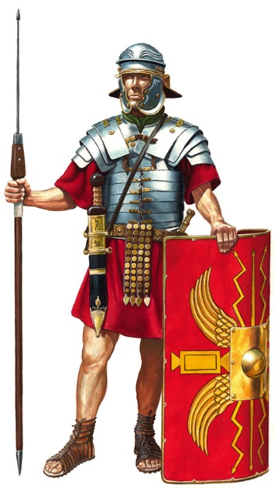
REVISION - ROMAN HISTORY
1/ Underline the correct answer:
-During which period did Rome dominate more territories?
Empire – monarchy – republic
-Who was the first emperor of Rome?
Brutus – Augustus – Tarquinius the Proud
-Who was the first king of Rome?
Romulus – Remus – Julius Cesar
-In which peninsula is Rome located?
Balcanic – iberian – Italian
Label the weapons of this soldier
3/ Why do we say that the legend of Romulus and Remus has no historical base?
4/ What did the Etruscan kings do for the city of Rome?
5/ What kind of kings were there in Rome before the Etruscan kings arrived?
6/ Which are the names of the seas that surround the Italic peninsula?

Slide 2
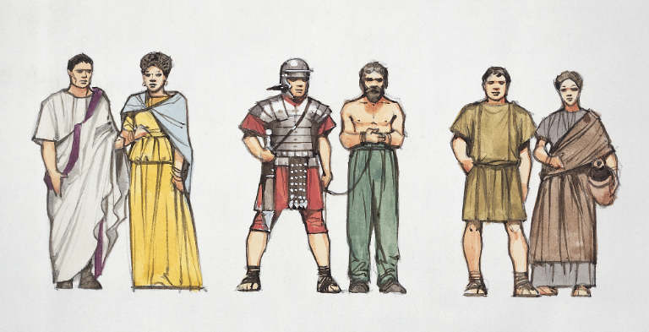
7/ Define the following words:
-Slave:
-Plebeian:
-Patrician:
-Senate:
-Monarchy:
-Republic:
-Empire:
-Magistrate:
-tribune:
8/ Label the social classes in ancient Rome, and state if they could or couldn’t vote
Name:
Could he vote?
Name:
Could he vote?
Name:
Could she vote?
Name:
Could he vote?
Name:
Could he vote?
9/ Why was Julius Cesar assassinated?
10/Read the text and fill the gaps with the words bellow
When Rome established a …………………………. in 509 B.C., two major classes developed. The ………………………. controlled the government with a Senate, made up of 300 elected officials. The senate chose two ……………………….. to administer the laws of Rome. Plebeians could not hold public office or marry into a patrician family. During the time of the Republic to the time of the ………………………….., plebeians, who fought in many ways to help Rome gain power, demanded more …………………………. The government slowly began to change to appeal to plebeians who out-numbered everyone else in population.

Slide 3
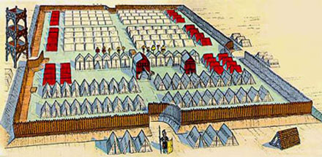
11/ These sentences are wrong. Correct them.
-The Republic was established when Romulus founded Rome
-The Roman Empire was very wealthy although it didn’t have good trade routes
-The slaves were very important in Rome because they approved the laws
-The large estates owned by patricians were worked by senators
-The presence of women in Roman Senate began in the republican period
12/ Label the parts of this military camp
13/ Why did the consuls and the senate give power to the military commanders during the Republic?
14/ What happened when the military commanders got the power after that?
15/ -Who was the first emperor of Rome? ………………………
-Who was the last emperor of Rome? ……………………….
16/ Why did the Empire get into a crisis?

Slide 4
 | MONARCHY | REPUBLIC | EMPIRE
Who commanded?
Who helped him/them to govern?
From when to when?
Why did it begin?
Why did it end?

